Slide 1

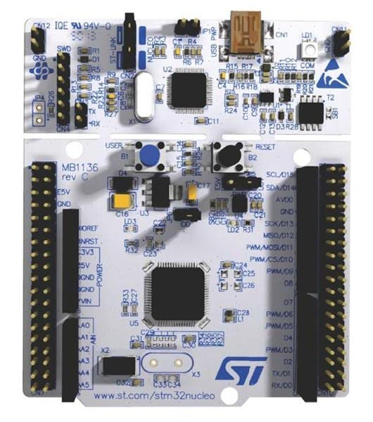
CORTEX-M4 INTERNALS
PRESENTED BY :–
DEEPAK KUMAR BENIYA

Slide 2
CONTENTS
IDE FEATURES
OPEARATIONAL MODES
ACCESS LEVEL
BUS MATRIX
PIPELINE ARCHITECTURE
MEMORY/NON MEMORY MAPPED REGISTERS
INLINE ASSEMBLY CODE
RESET SEQUENCE
IMPORTANT OF T-BITS
MEMORY MODEL
BUS PROTOCOL AND BUS INTERFACES
STACK MEMORY

Slide 3
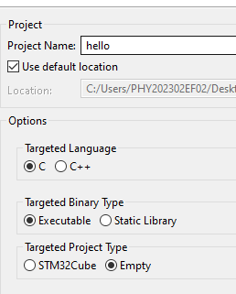
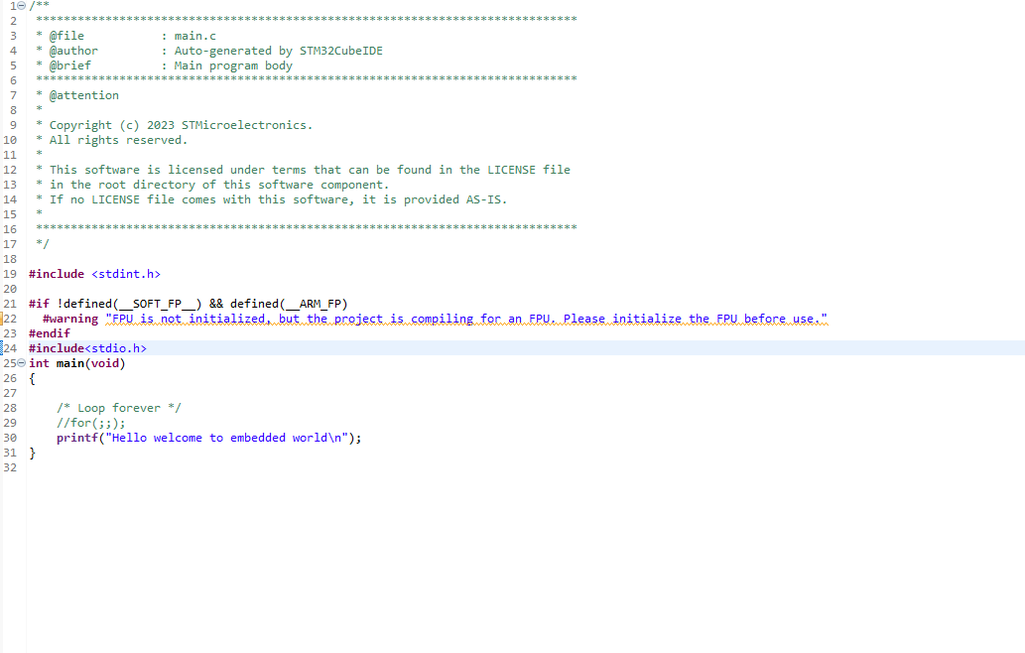
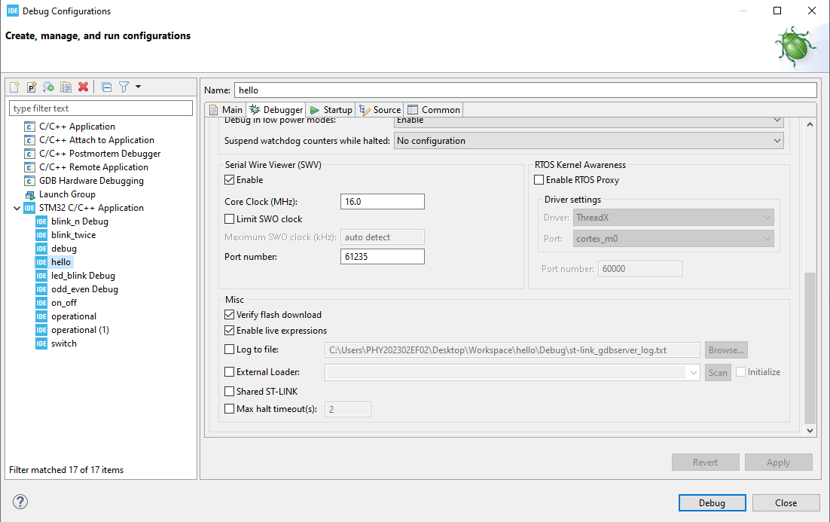
IDE FEATURES
STEP 1: Selection of board
STEP 2: Name of the project
STEP 3: Write the code
STEP 4: Defining & calling ITM_SendChar function
STEP 5: Change in properties
STEP 6: Build the project
STEP 7: Debug the project(choose stm32 application)
STEP 8: SWV ITM Data Console
STEP 9: SWV Properties
STEP 10: Display of the result
(in swv console)

Slide 4
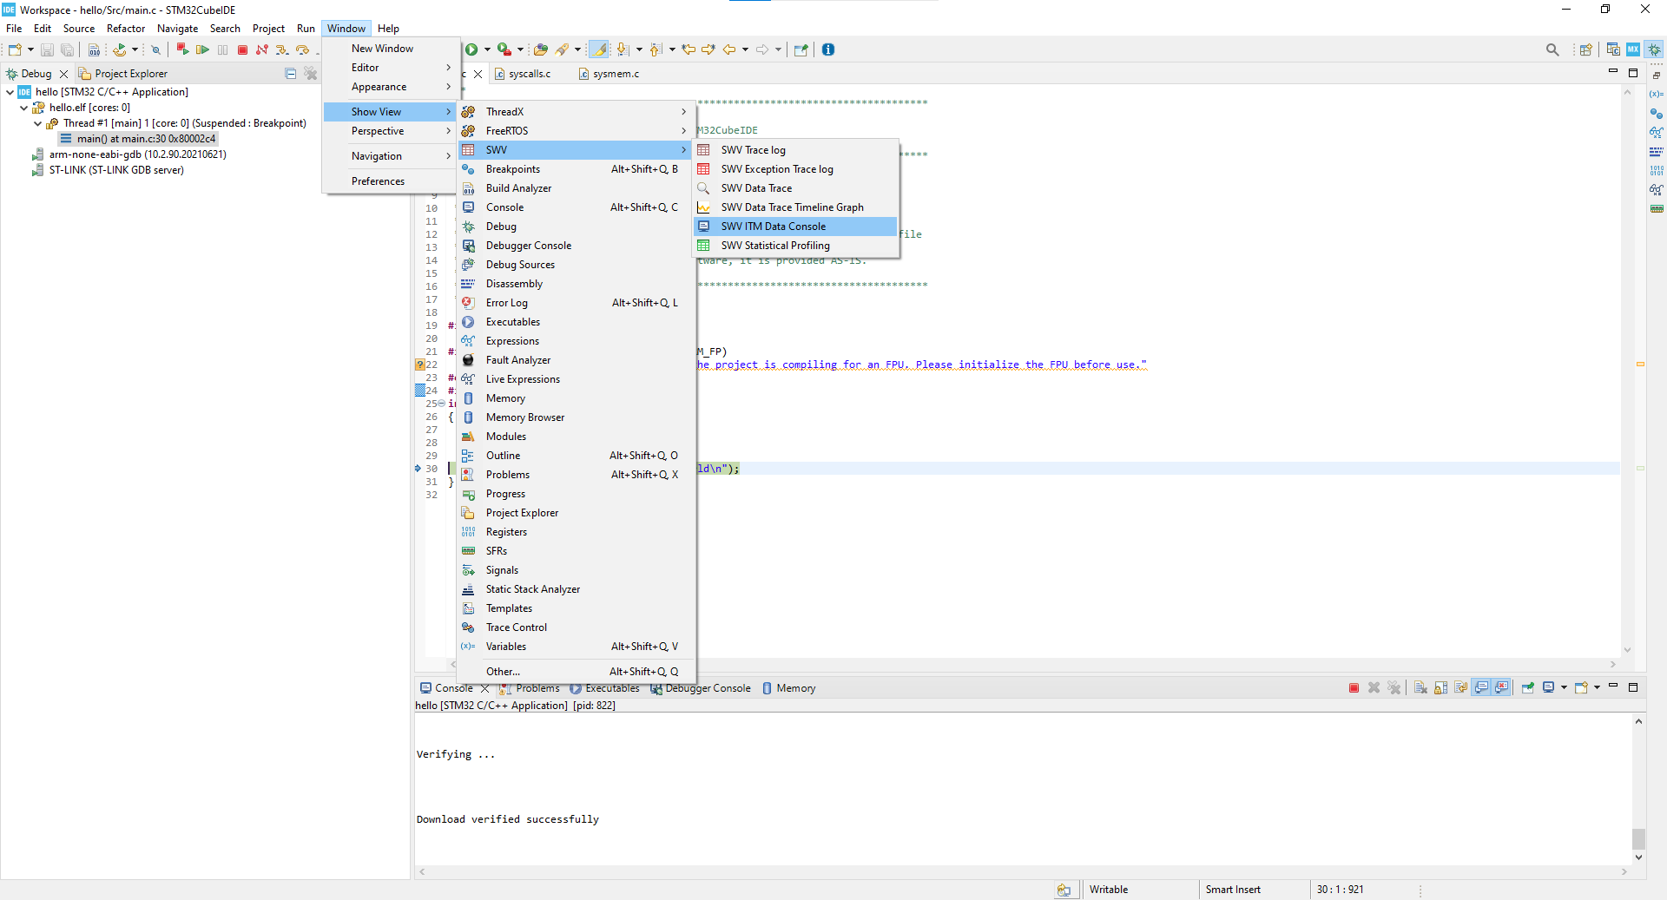
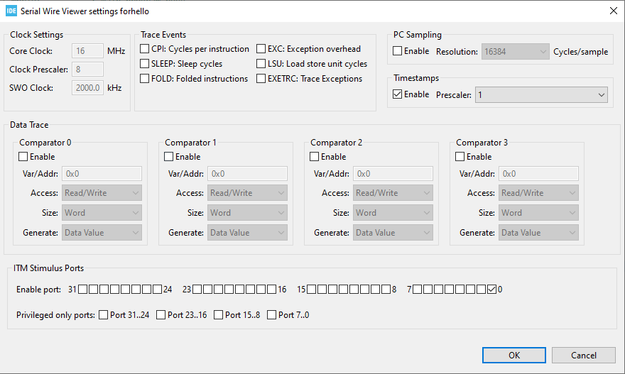
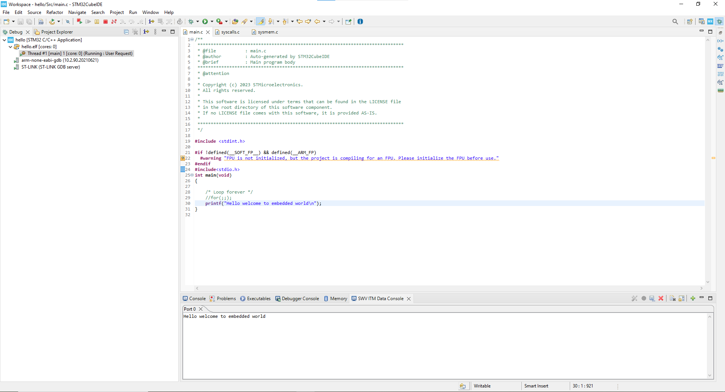
STEP 8: SWV ITM Data Console
STEP 9: SWV Properties
STEP 10: Display of the result (in swv console)

Slide 5
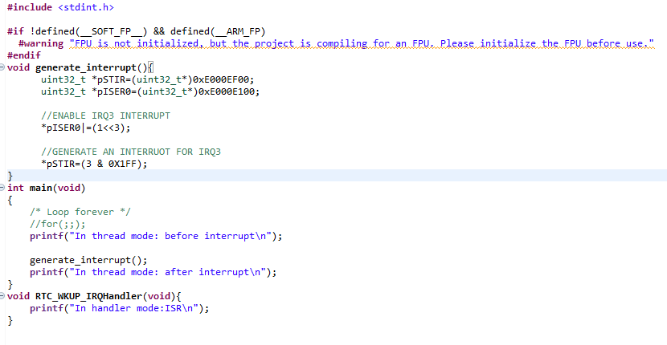
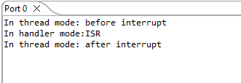
OPERATIONAL MODES
Processor gives two operational modes:
Thread mode:
Processor always starts with ‘Thread Mode’.
ii) Handler mode:
To service the ISR associated with the system exception or interrupt.

Slide 6
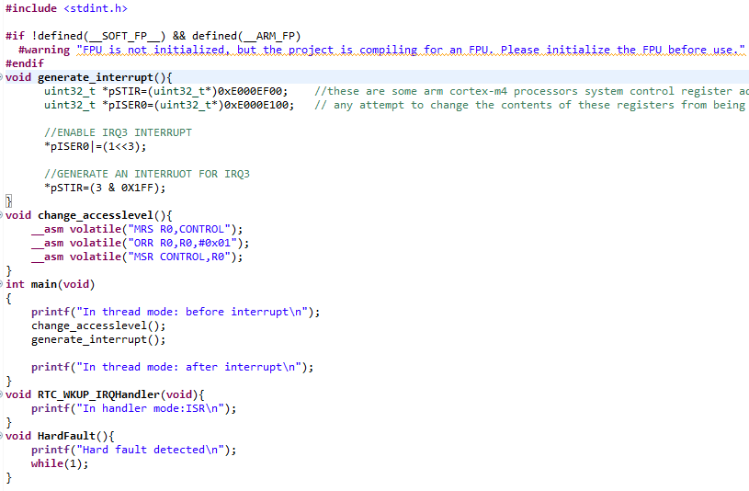
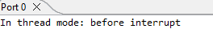
ACCESS LEVEL
The different access levels of processor:
Privileged Access Level(PAL): Use all the instructions and has access to all resources.
Non-Privileged Access Level(NPAL): code does not have access to some of the registers of the processor.
By default, the code will be executed in Privileged Access Level.
To change the access level, we need to change the [0] bit of counter.
Privileged: 0
Unprivileged: 1

Slide 7
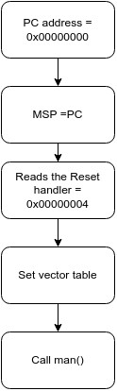
RESET SEQUENCE OF THE CORTEX M4 PROCESSOR
Reset_handler
Set the sp
Call the clock system initialization function.
Copy the data segment initializers from flash to SRAM .
Zero fill the bss segment.
Call static constructors
bl __libc_init_array(i.e branching all the standard library)
Call the application's entry point.
Bl main(call & start the main program)

Slide 8
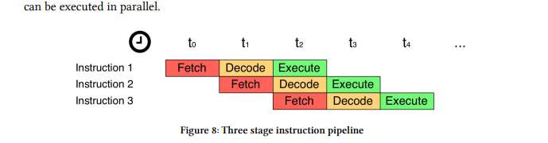
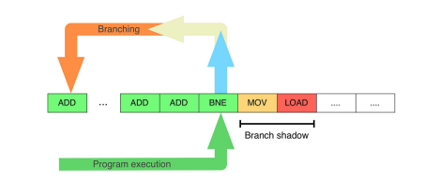
PIPELINE ARCHITECTURE
The Cortex-M4 processor is built on with a 3-stage pipeline Harvard architecture.
In Harvard architecture the data and instruction are
carried by two different bus ,one cycle is required
for execution(e.g. RISC) .
Rather than processing each instruction ,each instruction is split into a sequence of stages so that different steps can be executed in parallelly.

Slide 9
MEMORY MAPPED AND NON-MEMORY MAPPED REGISTERS
Non memory mapped : these registers are do not have any memory specified to them.
Memory mapped: These registers have unique address specified to them so that they can be identified. It is classified into two types:
Processor specific registers
E.g- NVIC, SWV, FPU, MPU, Debug, JTAG
Control specific registers
E.g-I2C, Timer, CAN, UART, ADC
IMPORTANCE OF T-BIT
The processor executes the code if
T-bit is 1, then ThumbISA
T-bit is 0, then ARMISA
The ARM cortex-M4 processor does not support the ARMISA state. Hence the T-bit of EPSR is always 1.

Slide 10
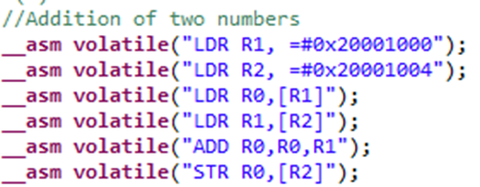
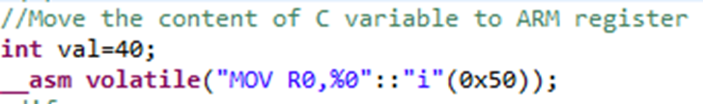
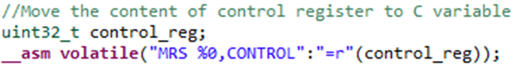
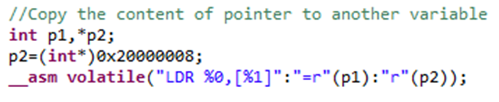
INLINE ASSEMBLY CODE
For non memory mapped register we use inline assembly code.
Syntax:
__asm volatile(code:output operand:input operand:cobbler list)
Arg1: Assembly mnemonic code defined as strong argument.
Arg2: A list of output operand seperated by colon.
Arg3: A list of input operand seperated by colon.
Arg4: Cobbler list is mainly used to the compiler about modification done by assembly code.

Slide 11
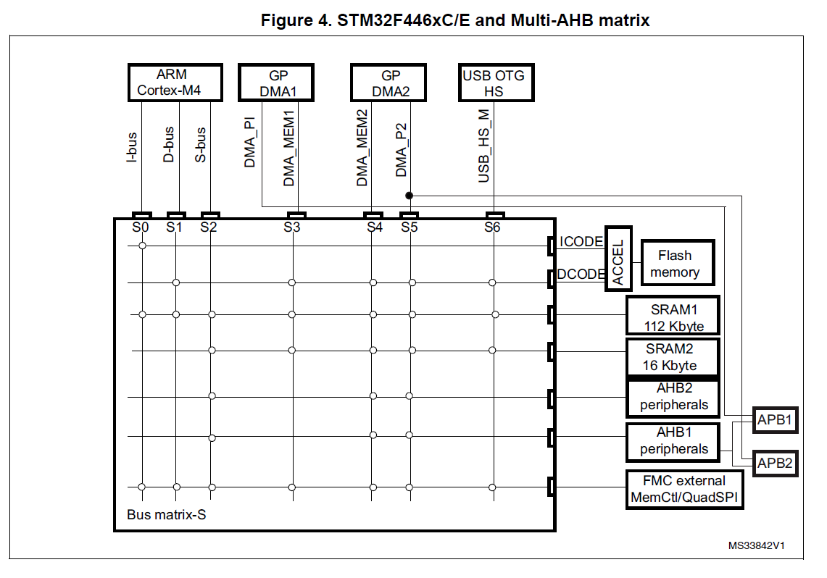
BUS MATRIX
Through bus matrix we know about how the core is connected to the peripherals.
Bus matrix is varied in different mcu.
The I bus and d bus is connected to flash memory through Icode and the dcode respectively.
The system bus is connected to the SRAM1,SRAM2, AHB1,AHB2 and the FMC externals/peripherals.
Fig: Bus matrix of stm32f446re

Slide 12
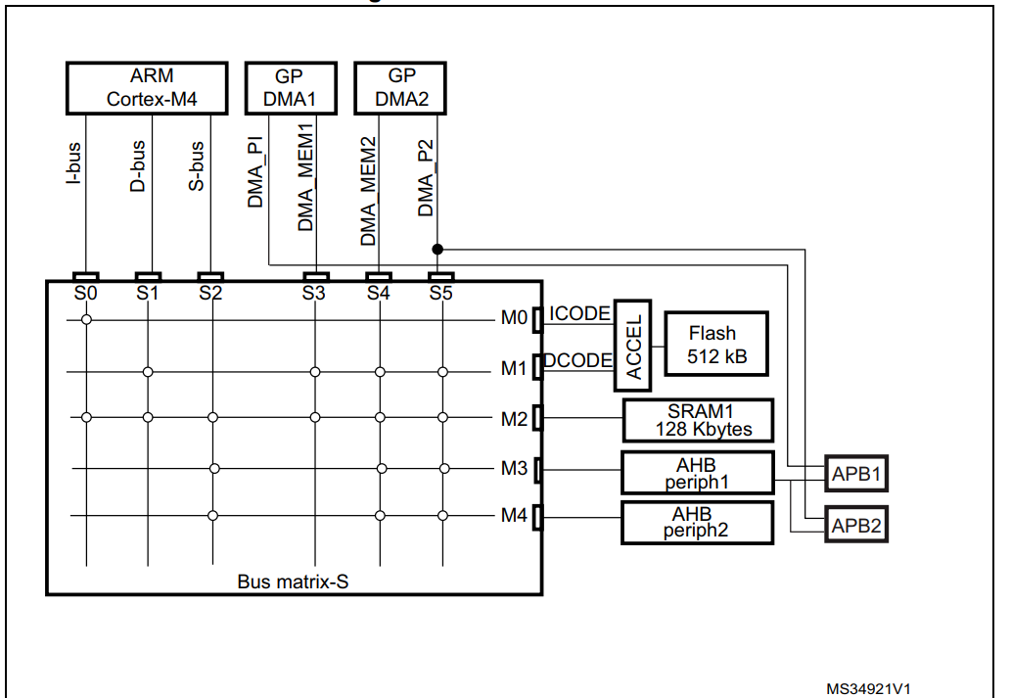
BUS MATRIX OF STM32F411
The I bus and d bus is connected to flash memory through Icode and the dcode respectively.
The core is connected to the SRAM through I-bus,D-bus,S-bus.
The system bus is connected to the SRAM, AHB1and AHB2.
Unlike F446RE here we don’t have the FMC externals and the QUAD SPI
Fig: Bus matrix of stm32f411

Slide 13
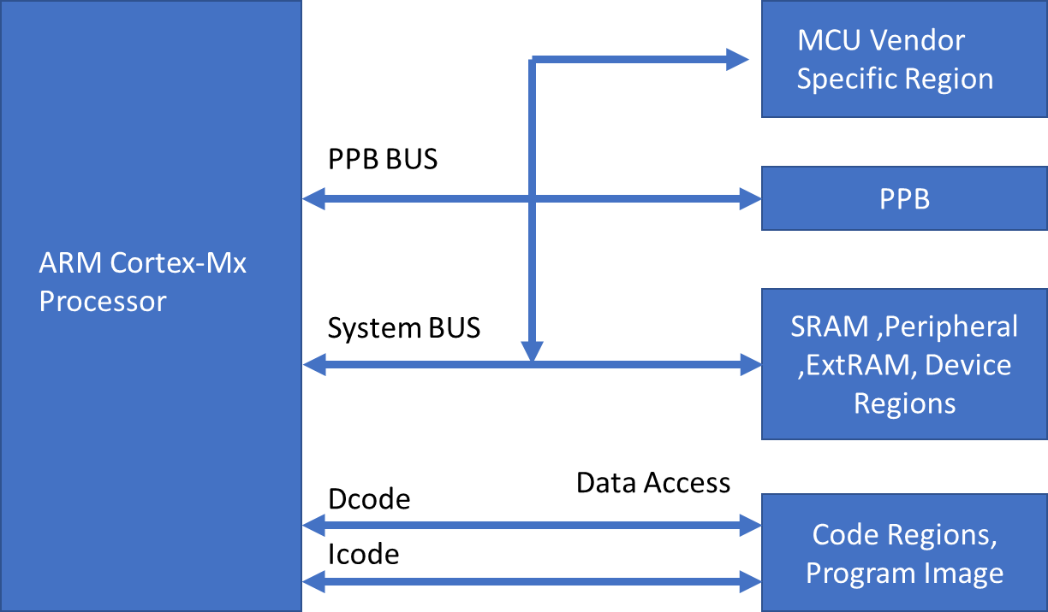
BUS PROTOCOLS AND BUS INTERFACES
IN Cortex-Mx processors the bus interfaces are based on Advance Microcontroller Bus Architecture specification.
AMBA governs standard for on-chip communication inside the SOC.
AMBA supports several bus protocols:
AHBLine (AMB High Performance Bus)
APB (AMB Peripheral Bus)

Slide 14
AHB
APB
AHB Line bus is mainly used for bus interfaces.
AHB Line bus is mainly use for high-speed communication with peripheral that demand high operation speed
APB bus is used for PPB access and some on-chip peripherals access using AHB & APB bridge.
APB bus is used for low-speed communication comparative of AHB.

Slide 15
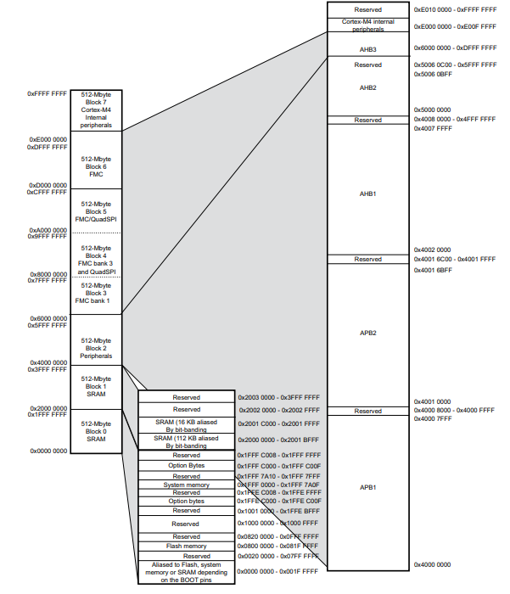
MEMORY MODEL
The mapping different regions in the addressable memory location range is called as memory map.
The processor has a fixed default memory map of 4GB address

Slide 16

STACK MEMORY
Stack memory is a part of main memory reserved for temporary storage of data.
It can be accessed using PUSH and POP instruction or any memory manipulation instructions
( LDR,STR).
The processor uses a full descending stack
In thread mode, bit[1] of the CONTROL register indicates:
0=Main Stack Pointer (MSP)
1=Process Stack Pointer (PSP)
200
DATA
SP
196
DATA OF R0
NEW SP
DECREMENT
Different stack operation models:
Full Ascending Stack
Full Descending Stack
Empty Ascending Stack
Empty Descending Stack
Here the sp is decremented first and then the data is written to the new memory location.
Example: PUSH R0

Slide 17
THANK YOU

